Slide 1
Balancing
Binary Search Trees

Slide 2
Binary Search Trees - Review
Tree walks Θ(n)
Queries
  Search O(h)
  Minimum O(h)
  Maximum O(h)
  Successor O(h)
  Predecessor O(h)
Modifying
  Insert O(h)
  Delete O(h)
Each of the basic operations on a binary search tree runs in O(h) time, where h is the height of the tree
The height of a binary search tree of n nodes depends on the order in which the keys are inserted
The height of a BST with n nodes:
  Worst case: O(n) => BST operations are also O(n) !!!
  Best case: O(log n)
  Average case O(log n)

Slide 3
Binary Search Trees - Review
Tree walks Θ(n)
Queries
  Search O(h)
  Minimum O(h)
  Maximum O(h)
  Successor O(h)
  Predecessor O(h)
Modifying
  Insert O(h)
  Delete O(h)
Each of the basic operations on a binary search tree runs in O(h) time, where h is the height of the tree
The height of a binary search tree of n nodes depends on the order in which the keys are inserted
The height of a BST with n nodes:
  Worst case: O(n) => BST operations are also O(n) !!!
  Best case: O(log n)
  Average case O(log n)
Conclusion: we must do something to make sure that the height is kept small !
The BST must be always (kind of) balanced

Slide 4
Balanced Binary Search Trees
A BST is perfectly balanced if, for every node, the difference between the number of nodes in its left subtree and the number of nodes in its right subtree is at most one
Example: Balanced tree vs Not balanced tree

Slide 5
Balancing Binary Search Trees
Inserting or deleting a node from a (balanced) binary search tree can lead to an unbalance
In this case, we perform some operations to rearrange the binary search tree in a balanced form
  These operations must be easy to perform and must require only a minimum number of links to be reassigned
  Such kind of operations are Rotations

Slide 6
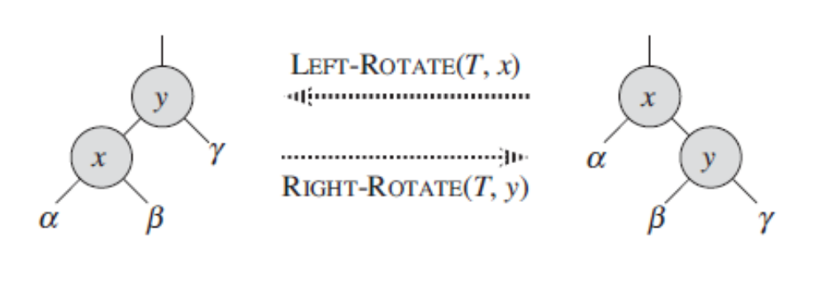
Tree Rotations
The basic tree-restructuring operation
There are left rotation and right rotation. They are inverses of each other
[CLRS Fig. 13.1]

Slide 7
Tree Rotations
Changes the local pointer structure. (Only pointers are changed.)
A rotation operation preserves the binary-search-tree property: the keys in α precede x.key, which precedes the keys in β, which precede y.key, which precedes the keys in γ .

Slide 8
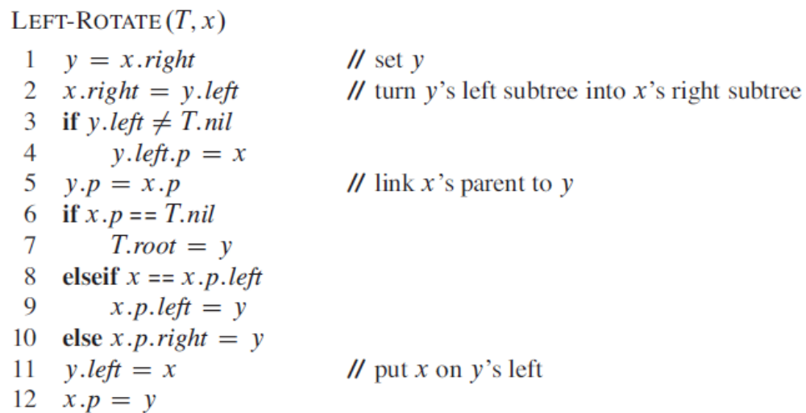
Implementing Rotations

Slide 9
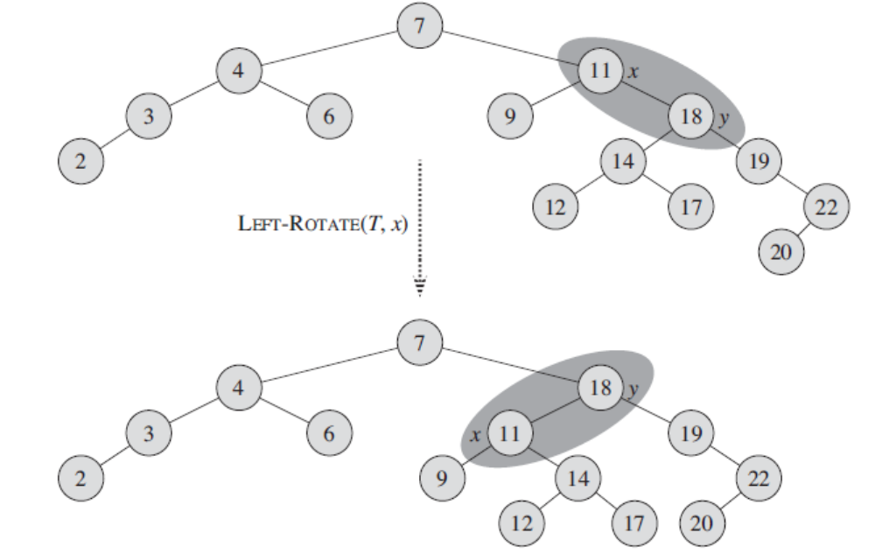
[CLRS Fig. 13.3]

Slide 10
Balancing Binary Search Trees
Balancing a BST is done by applying simple transformations such as rotations to fix up after an insertion or a deletion
Perfectly balanced BST are very difficult to maintain
Different approximations are used for more relaxed definitions of “balanced”, for example:
  AVL trees
  Red-black trees

Slide 11
AVL trees
Adelson Velskii and Landes
An AVL tree is a binary search tree that is height balanced: for each node x, the heights of the left and right subtrees of x differ by at most 1.
AVL Tree vs Non-AVL Tree

Slide 12
AVL Trees
AVL trees are height-balanced binary search trees
Balance factor of a node
  height(left subtree) - height(right subtree)
An AVL tree has balance factor calculated at every node
  For every node, heights of left and right subtree can differ by no more than 1

Slide 13
Height of an AVL Tree
How many nodes are there in an AVL tree of height h ?
N(h) = minimum number of nodes in an AVL tree of height h.
Base Case:
  N(0) = 1, N(1) = 2
Induction Step:
  N(h) = N(h-1) + N(h-2) + 1
Solution: (it’s the Fibonacci recurrence)
  N(h) =φ^{h} (φ ≈ 1.62)
h
h-2
h-1

Slide 14
Height of an AVL Tree
N(h)=φ^{h} (φ ≈ 1.62)
What is the height of an AVL Tree with n nodes ?
Suppose we have n nodes in an AVL tree of height h.
  n > N(h) (because N(h) was the minimum)
  n > φ^{h} hence log_{φ} n > h
  h ≤ log_{φ} n = log₂ n / log₂ φ
  h < 1.44 log₂n ( h is O(logn))

Slide 15
Insertion into an AVL trees
place a node into the appropriate place in binary search tree order
examine height balancing on insertion path:
  Tree was balanced (balance=0) => increasing the height of a subtree will be in the tolerated interval +/-1
  Tree was not balanced, with a factor +/-1, and the node is inserted in the smaller subtree leading to its height increase => the tree will be balanced after insertion
  Tree was balanced, with a factor +/-1, and the node is inserted in the taller subtree leading to its height increase => the tree is no longer height balanced (the heights of the left and right children of some node x might differ by 2)
    we have to balance the subtree rooted at x using rotations
    How to rotate ? => see 4 cases according to the path to the new node

Slide 16
Example – AVL insertions
RIGHT-ROTATE
10
2
2
15
1
10
1
8
0
8
15
0
Case 1: Node’s Left – Left grandchild is too tall

Slide 17
AVL insertions – Right Rotation
Case 1: Node’s Left – Left grandchild is too tall
y
x
Balance: 0
Balance: 2
x
y
h+2
Balance: 1
h+2
h
h
h
h
h
h
Height of tree after balancing is the same as before insertion !

Slide 18
Example – AVL insertions
8
5
8
5
15
3
8
3
15
2
4
15
2
5
3
4
2
4
Solution: do a Double Rotation: LEFT-ROTATE and RIGHT-ROTATE
Case 2: Node’s Left-Right grandchild is too tall

Slide 19
Double Rotation – Case Left-Right
Case 2: Node’s Left-Right grandchild is too tall
Balance: 2
z
x
h+2
Balance: -1
y
h
h-1
h-1

Slide 20
Double Rotation – Case Left-Right
Balance: 0
y
Balance: 0 or 1
Balance: 0 or -1
x
z
h+2
h-1
h-1
h
h
Height of tree after balancing is the same as before insertion !
=> there are NO upward propagations of the unbalance !

Slide 21
Exercise
Insert following keys into an initially empty AVL tree. Indicate the rotation cases:
14, 17, 11, 7, 3, 13

Slide 22
Example – AVL insertions
LEFT-ROTATE
10
15
2
15
10
20
13
20
2
13
25
25
Case 3: Node’s Right – Right grandchild is too tall

Slide 23
AVL insertions – Left Rotation
Case 3: Node’s Right – Right grandchild is too tall
x
y
Balance: 0
Balance: -2
y
x
Balance: -1
h
h
h
h
h
h

Slide 24
Example – AVL insertions
5
7
5
3
7
5
8
3
8
6
3
6
15
7
8
15
6
15
Solution: do a Double Rotation: RIGHT-ROTATE and LEFT-ROTATE
Case 4: Node’s Right – Left grandchild is too tall

Slide 25
Double Rotation – Case Right-Left
Case 4: Node’s Right – Left grandchild is too tall
x
Balance: -2
z
Balance: 1
y
h
Balance: 1 or -1
h
h-1
h-1

Slide 26
Double Rotation – Case Right-Left
Balance: 0
y
Balance: 0 or 1
Balance: -1 or 0
x
z
h-1
h-1
h
h

Slide 27
Implementing AVL Trees
Insertion needs information about the height of each node
It would be highly inefficient to calculate the height of a subtree every time this information is needed => the tree structure is augmented with height information that is maintained during all operations
An AVL Node contains the attributes:
  Key
  Left, right, p
  Height (or Balance Factor)

Slide 28
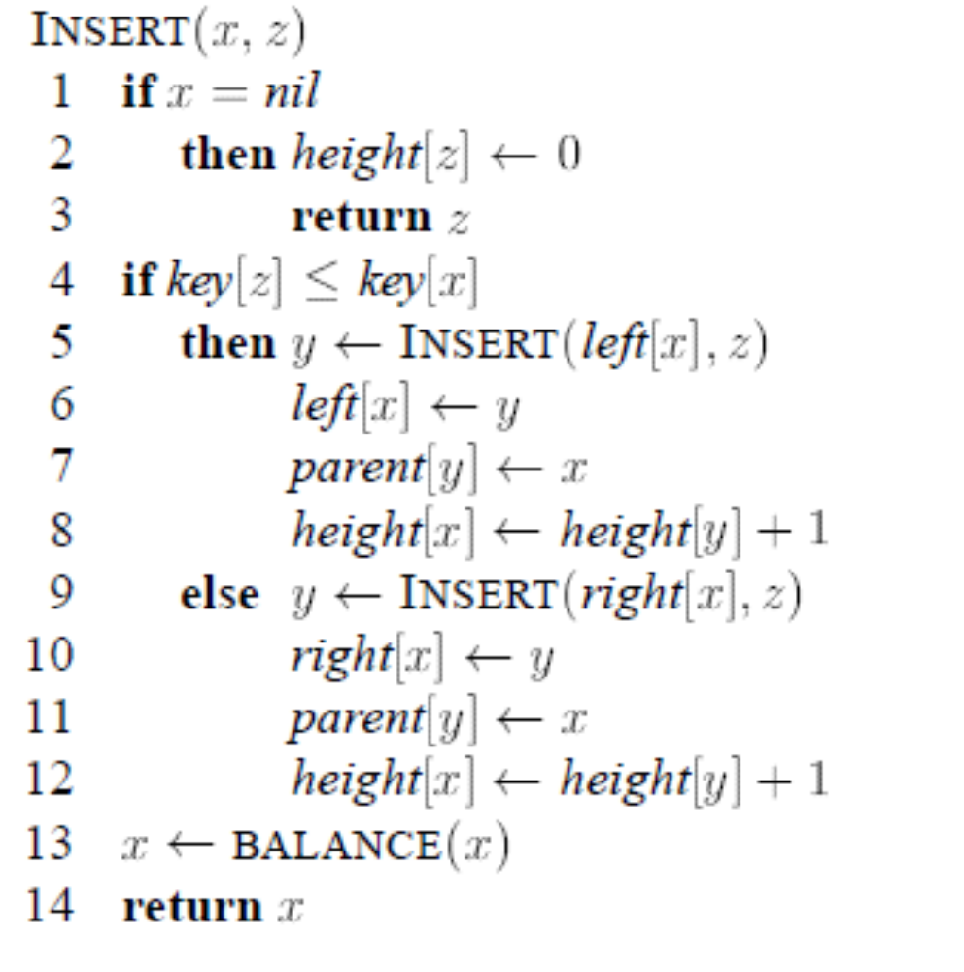

Slide 29
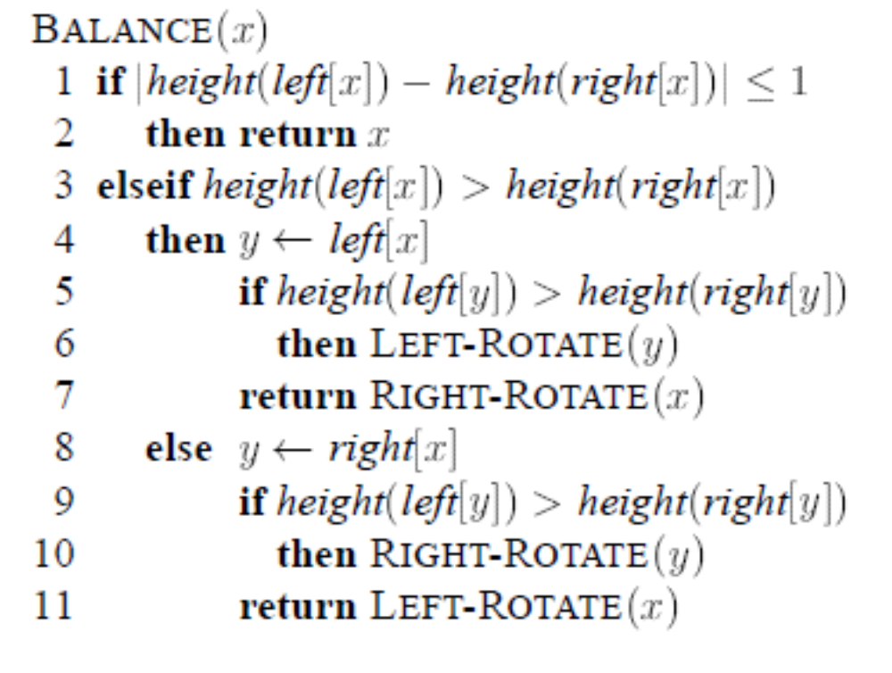
<
Case 2 – Left-Right
Case 1 – Left-Left
Case 4 – Right-Left
Case 3 – Right-Right

Slide 30
Do not forget implementation details:
The height information in nodes must be updated during rotations !
ONLY the height information of nodes x and y must be updated !

Slide 31
Analysis of AVL-INSERT
Insertion makes O(h) steps, h is O(log n), thus Insertion makes O(log n) steps
At every insertion step, there is a call to Balance, but rotations will be performed only once for the insertion of a key. It is not possible that after doing a balancing, unbalances are propagated , because the BALANCE operation restores the height of the subtree before insertion. => number of rotations for one insertion is O(1)
AVL-INSERT is O(log n)

Slide 32
Thinking question
Can we replace the conditions for performing rotations, by just changing height into number of nodes in order to maintain a perfectly balanced tree instead of an AVL balanced tree ?

Slide 33
<

Slide 34
AVL Delete
The procedure of BST deletion of a node z:
  1 child: delete it, connect child to parent
  2 children: put successor in place of z, delete successor
Which nodes’ heights may have changed:
  1 child: path from deleted node to root
  2 children: path from deleted successor leaf to root
AVL Tree may need rebalancing as we return along the deletion path back to the root

Slide 35
AVL delete – Right Rotation
Case 1: Node’s Left-Left grandchild is too tall
y
x
Balance: 0
Balance: 2
x
y
Balance: 1
h+1
h+2
h-1
h
h-1
h-1
h-1
h
Delete node in right child, the height of the right child decreases
The height of tree after balancing decreases !=> Unbalance may propagate

Slide 36
AVL delete – Double Rotation
Case 2: Node’s Left-Right grandchild is too tall
y
Balance: 0
z
Balance: 2
x
x
z
h+2
Balance: 1
h+1
y
h-1
h-1
h-1
h-1
h-1
h-1
h-1
h-1
Delete node in right child, the height of the right child decreases
The height of tree after balancing decreases !=> Unbalance may propagate

Slide 37
AVL delete – Left Rotation
Case 3: Node’s Right – Right grandchild is too tall
x
y
Balance: 0
Balance: -2
y
x
Balance: -1
h+2
h-1
h+1
h-1
h-1
h-1
h
h
Delete node in left child, the height of the left child decreases
The height of tree after balancing decreases !=> Unbalance may propagate

Slide 38
AVL delete – Double Rotation
Case 4: Node’s Right – Left grandchild is too tall
x
y
Balance: 0
Balance: -2
z
x
z
Balance: 1
h+2
h-1
h+1
y
h-1
h-1
h-1
h-1
h-1
h-1
h-1
Delete node in left child, the height of the left child decreases
The height of tree after balancing decreases !=> Unbalance may propagate

Slide 39
Analysis of AVL-DELETE
Deletion makes O(h) steps, h is O(log n), thus deletion makes O(log n) steps
At the deletion of a node, rotations may be performed for all the nodes of the deletion path which is O(h)=O(log n) ! In the worst case, it is possible that after doing a balancing, unbalances are propagated on the whole path to the root !

Slide 40
Exercise
11
7
14
5
9
12
17
3
6
8
10
20
1
What happens if key 12 is deleted ?

Slide 41
AVL Trees - Summary
AVL definition of balance: for each node x, the heights of the left and right subtrees of x differ by at most 1.
Maximum height of an AVL tree with n nodes is h < 1.44 log₂n
AVL-Insert: O(log n), Rotations: O(1) (For Insert, unbalances are not propagated after they are solved once)
AVL-Delete: O(log n), Rotations: O(log n) (For Delete, unbalances may be propagated up to the root)

Slide 42
AVL vs Simple BST
 | AVL | Simple BST
Max Height | 1.44 log n | n
INSERT | O(log n) | O(n)
Rotations at Insert | O(1)
DELETE | O(log n) | O( n)
Rotations at Delete | O(log n)

Slide 43
Conclusions - Binary Search Trees
BST are well suited to implement Dictionary and Dynamic Sets structures (Insert, Delete, Search)
In order to keep their height small, balancing techniques can be applied
  AVL is one of these techniques

